Slide 1
Lecture 2
Operating Systems
CoSc2043 – Network and System Administration

Slide 2
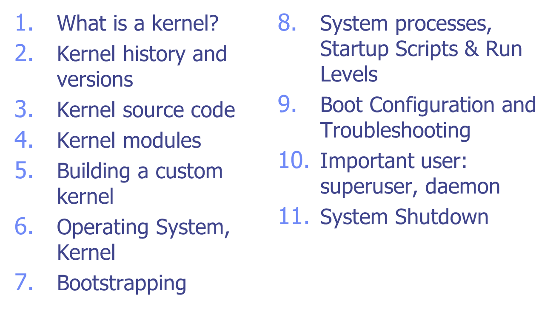
Topics

Slide 3
What is an OS kernel?
Program that is always running.
  Manages resources.
  Provides services.
Layering
  Layer between programs and hardware.
  Layer between users (multiuser OS).
  Layer between programs (multitasking OS).

Slide 4
Examples of Operating Systems
DOS - Disk Operating System
Windows
MacOS
Unix – Linux
Unix – Linux: originally created with a command-line interface, but recently have added GUI enhancements.

Slide 5

What is an OS kernel?

Slide 6
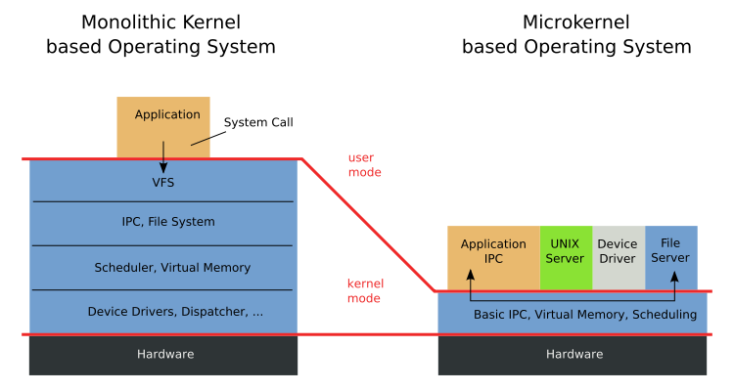
Monolithic vs. Microkernels
Source:http://en.wikipedia.org/wiki/Microkernel

Slide 7
Resource Management
Allocation
  Allocates finite resources among competing processes.
  CPU, memory, disk, network
Protection
  Prevents processes from interfering with each other.
Reclamation
  Voluntary at runtime; automatic at termination.
Virtualization
  Provides illusion of private unshared resources
  Timeshared CPU, Virtual Memory, Virtual Machines

Slide 8

What is the Linux kernel?
Free open source UNIX-compatible kernel.
  Created by Linus Torvalds.
  Developed by thousands across the world.
  Coordinated via linux-kernel mailing list.

Slide 9
Kernel History
0.01 First version released by Linus (1991).
1.0 First release (x86 only) in 1994.
1.2 Supports other CPUs (Alpha, MIPS) in 1995.
2.0 SMP support, more architectures (1996).
2.2 Efficient SMP, more hardware support (1999).
2.4 LVM, Plug-n-Play, USB, etc. (2001).
2.6 Scalability (embedded, NUMA, PAE, sched), kernel pre-emption, User-mode linux (2003).

Slide 10
Version Numbering: A.B.C.D
A: Major version
  Changed twice: 1.0 (1994), 2.0 (1996)
B: Minor version
  Even numbers are stable releases
  Odd numbers are development releases
C: Minor revision
  Not so minor in 2.6 as development continues.
D: Bug-fix / security patch release
  First occurred with NFS bug in 2.6.8.1
  Official policy as of 2.6.11

Slide 11
Kernel Versions
mm: Andrew Morton tree
  New patches, almost ready for distribution.
ac: Alan Cox tree
Distribution trees
  RedHat
  Mandrake
  Debian
  Gentoo, etc.

Slide 12
Identifying the Running Kernel
> uname
Linux
> uname -r
2.6.10
> cat /proc/version
Linux version 2.6.10(jw@csc660) (gcc version 3.3.5) #3 Sun Dec 25 10:22:50 EST 2005

Slide 13
Investigating the Running Kernel: /proc
###: directory for each running process
cpuinfo: processor information
devices: supported hardware
diskstats: disk performance statistics
meminfo: memory usage information
modules: linux kernel modules
net: directory of network information
partitions: linux disk partitions
swaps: swap files/partitions in use by kernel
self: link to ### directory for current process

Slide 14
Bootstrapping
Starting the system
Process of loading kernel into memory
Boot Modes
  Normal
  Single User
  Rescue (on CD)

Slide 15
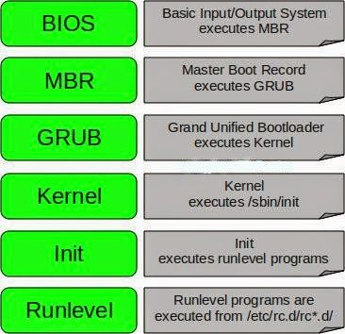
Boot Process
Load & initialize kernel
Detect & configure devices
Fork system processes
(Stop if Single User mode)
Run startup scripts
Start multiuser operations
Linux Boot Process
Source: https://icssindia.in/linux-boot-process/

Slide 16
Boot Loader
ROM loads boot program from disk
Boot program finds/loads kernel
  Checks available memory
  Initializes kernel internal data structures
GRand Unified Bootloader (GRUB)
  Can boot multiple OS
  Boot options can be edited at boot
Linux Boot Loader (LILO)
  Can boot multiple OS
  Single User: linux single
  Rescue: linux rescue

Slide 17
/etc/grub.conf
default=1
timeout=10
splashimage=(hd0,5)/boot/grub/splash.xpm.gz
title Fedora Core - N321 (2.6.11-1.1369_FC4)
root (hd0,5)
kernel /boot/vmlinuz-2.6.11-1.1369_FC4 ro
root=LABEL=/1 rhgb quiet initrd
/boot/initrd-2.6.11-1.1369_FC4.img
title Windows XP
rootnoverify (hd0,0)
chainloader +1
title Red Hat Enterprise WS (2.6.9-11.EL)
rootnoverify (hd0,4)
kernel /boot/vmlinuz-2.6.9-11.EL ro
root=LABEL=/ rhgb quiet initrd
/boot/initrd-2.6.9-11.EL.img

Slide 18
System Processes
A process is an instance of a program in execution
BSD Systems
  swapper – PID 0
  init – PID 1
  pagedaemon – PID 2
AT&T SVR4
  sched – PID 0 (invisible under RedHat)
  init – PID 1
  /etc/inittab

Slide 19
Startup Scripts
Hostname
Timezone
Check the hard drives
Mount the hard drives
Remove files from /tmp
Configure network interfaces
Start daemons and network services

Slide 20
BSD /etc/rc* Scripts
/etc/rc
  Master script
  Executes supplemental scripts
Example supplemental scripts (freeBSD)
  /etc/defaults/rc.conf
  /etc/rc.conf
  /etc/rc.conf.local

Slide 21
/etc/inittab
Initializes system for use
Format: id:rl:action:process
  id: uniquely identifies entry
  rl: Run level entry applies to
  action: How to execute process
  process: process command line
Ex: Setting the default Runlevel:
  id:3:initdefault:

Slide 22
Startup Run Levels
Solaris | RedHat | Mode
1 (S) | 1 (S) | Single user
2 | 2 | Multiuser (no networking)
3 | 3 | Full Multiuser
4 | 4 | Unused
5 |  | Power-off shutdown
 | 5 | X11
6 | 6 | Reboot
0 | 0 | Halt

Slide 23
Event file directives
exec
script
start on <event>
stop on <event>
daemon
respawn
service

Slide 24
“Events”
control-alt-delete
power-status-changed
startup
runlevel <runlevel>
started <job>
stopped <job>

Slide 25
Process information
> ls -alF /proc/self
dr-xr-xr-x 2 jw jw 0 2005-12-29 13:46 attr/
-r-------- 1 jw jw 0 2005-12-29 13:46 auxv
-r--r--r-- 1 jw jw 0 2005-12-29 13:46 cmdline
lrwxrwxrwx 1 jw jw 0 2005-12-29 13:46 cwd -> /proc/20041/
-r-------- 1 jw jw 0 2005-12-29 13:46 environ
lrwxrwxrwx 1 jw jw 0 2005-12-29 13:46 exe -> /bin/bash*
dr-x------ 2 jw jw 0 2005-12-29 13:46 fd/
-r--r--r-- 1 jw jw 0 2005-12-29 13:46 maps
-rw------- 1 jw jw 0 2005-12-29 13:46 mem
-r--r--r-- 1 jw jw 0 2005-12-29 13:46 mounts
lrwxrwxrwx 1 jw jw 0 2005-12-29 13:46 root -> //
-r--r--r-- 1 jw jw 0 2005-12-29 13:46 stat
-r--r--r-- 1 jw jw 0 2005-12-29 13:46 statm
-r--r--r-- 1 jw jw 0 2005-12-29 13:46 status
dr-xr-xr-x 3 jw jw 0 2005-12-29 13:46 task/
-r--r--r-- 1 jw jw 0 2005-12-29 13:46 wchan

Slide 26
Process information
> cd /proc/self
> cat cmdline ; echo
-bash
> cat environ | tr '\0' '\n' | head -8
ENV_SET=1
MANPATH=/usr/local/man:/usr/man:/usr/share/man
PATH=/usr/ucb:/usr/bin:/bin:/sbin:/usr/sbin:/usr/local/bin
TERM=xterm
SHELL=/bin/bash
EDITOR=vim
VISUAL=vim
PAGER=less
> ls -l fd
total 4
lrwx------ 1 jw jw 64 2005-12-29 13:50 0 -> /dev/pts/3
lrwx------ 1 jw jw 64 2005-12-29 13:50 1 -> /dev/pts/3
lrwx------ 1 jw jw 64 2005-12-29 13:50 2 -> /dev/pts/3

Slide 27
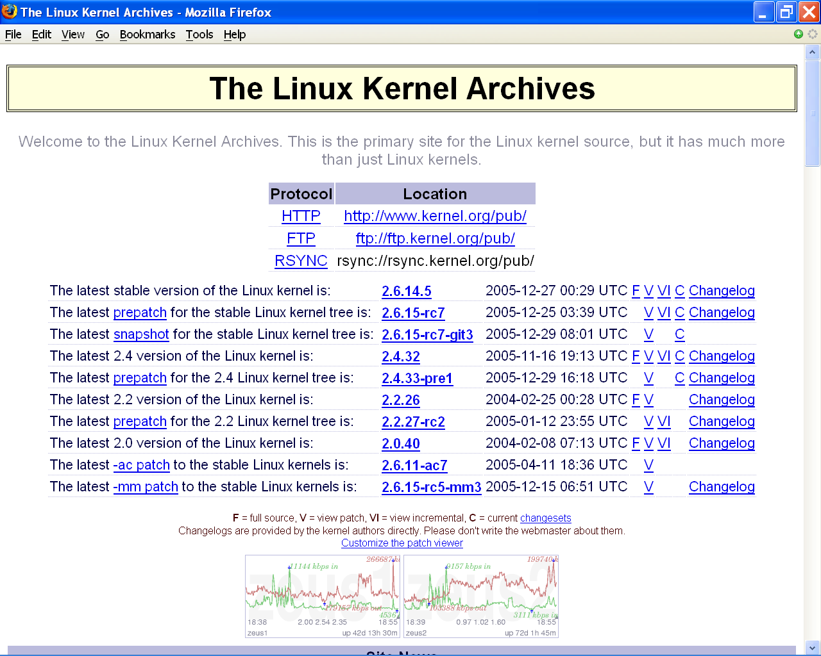
Obtaining the Kernel
Slide #<number>

Slide 28
Prepatches and Snapshots
Prepatches
  Alpha versions of the kernel, located in the testing/ subdirectory of kernel.org.
Snapshots
  Automatically created images of the kernel development tree. May not work or compile.

Slide 29
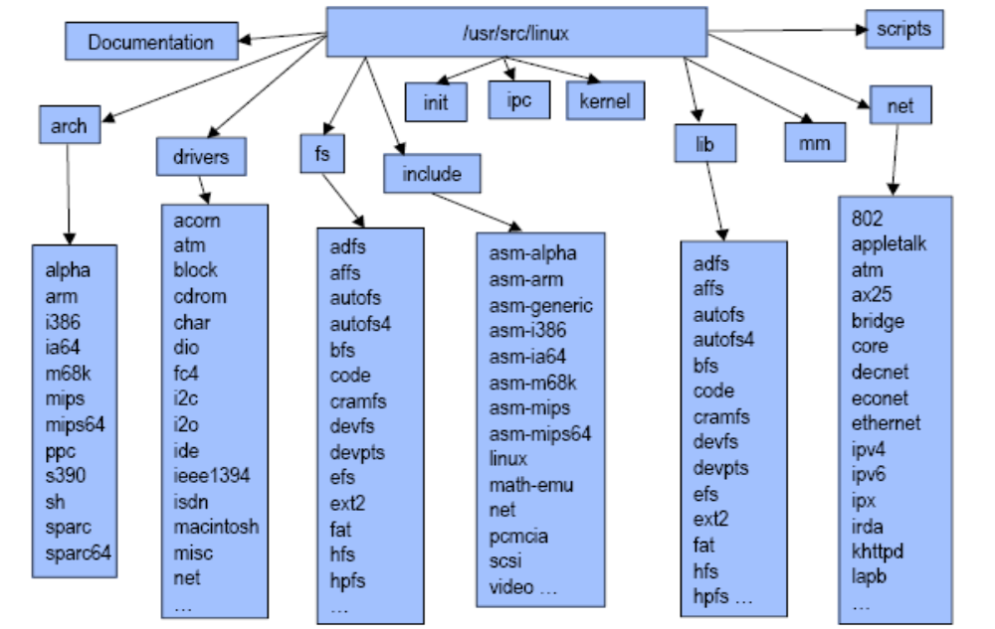
Linux Source Layout

Slide 30
Documentation
Text files documenting various aspects of kernel
  Can be very useful.
  Not well organized.
  Not always up to date.

Slide 31
What are Kernel Modules?
Parcels of code that can be dynamically inserted or removed from kernel at run time.

Slide 32
Why use Kernel Modules?
Ease of maintenance
  Compile kernel once.
  Build, add, and remove modules afterwards.
Ease of distribution
  Compile single kernel for all machines.
  Include drivers / options as modules.
  Vendors can distribute drivers as modules.

Slide 33
Why not use kernel modules?
Performance
  There is a minor performance hit to using.
  Doesn’t save RAM like dynamic user libraries, since there are no other kernels to share with.
Security
  If attacker can load module, can control kernel.
  Kernel mode rootkits control system invisibly
    Hides attacker processes, files, network connections.
    Runs backdoors, sniffers, etc. w/o starting processes.

Slide 34
What modules are loaded?
> lsmod | head
Module Size Used by
vmnet 31900 12
vmmon 103584 0
proc_intf 4100 0
freq_table 4100 0
cpufreq_userspace 4572 0
cpufreq_ondemand 6172 0
cpufreq_powersave 1920 0
video 16260 0
sony_acpi 6280 0
> head -3 /proc/modules
vmnet 31900 12 - Live 0xf8c3a000
vmmon 103584 0 - Live 0xf8c85000
proc_intf 4100 0 - Live 0xf8c2c000

Slide 35
Loading Kernel Modules
modprobe name
  Lookup name
  Resolve aliases using /etc/modprobe.conf
  Check dependencies
  /lib/modules/version/modules.dep
  Created by depmod –a
  Load prerequisite modules with insmod
  Load named module.

Slide 36
Module Licensing
Module licenses
  GPL
  Dual BSD/GPL
  Proprietary
Why does licensing matter?
  So modinfo can tell users if kernel is free.
  So community can ignore bug reports including proprietary modules.
  So vendors can do likewise based on their own policies.
Notes:
Berkeley Source Distribution
BSD licenses are a low restriction type of license for open source software that does not put requirements on redistribution. As a low restriction and requirement license type, Berkeley Source Distribution (BSD) licenses are used for the distribution of many freeware, shareware and open source software.
A proprietary license model is based on the concept that the software company creates software and maintains control over its code, and therefore, its features and use.
General Public License
GPL is the acronym for GNU's General Public License

Slide 37
Rebuilding the Kernel
Why would you want to?
  Current kernel incompatible with your hardware.
  Current kernel has a bug on your system.
  Current kernel is missing a feature you need.
  Vendor kernel uses too much RAM/disk.
Which kernel to start with?
  Generic kernel from kernel.org.
  Vendor kernel source from your distribution.

Slide 38
Quick Kernel Build
Configure
  make xconfig
Build
  make –j3 bzImage
Build modules
  make -j3 modules && make modules_install
Install
  cp arch/i386/boot/bzImage /boot/bzImage-VERSION
  cp System.map /boot/System.map-VERSION
  vim /boot/grub/menu.lst

Slide 39
Configuring the Kernel
kbuild: the kernel build system
Kernel configuration
  cp .config config.save Backup old config file.
  make mrproper Clean up from prior builds.
  vim .config Make configuration changes.
Interfaces
  make config Sequential questions on cli
  make menuconfig Ncurses-based menu interface
  make xconfig QT-based graphical interface
  make gconfig GTK-based graphical interface

Slide 40
.config
CONFIG_<NAME> options
y Include in kernel
n Don’t include in kernel
m Build as a kernel module (not for all items)
# Linux kernel version: 2.6.10
CONFIG_X86=y
CONFIG_MMU=y
CONFIG_UID16=y
CONFIG_GENERIC_ISA_DMA=y
CONFIG_GENERIC_IOMAP=y
# Code maturity level options
CONFIG_EXPERIMENTAL=y
CONFIG_CLEAN_COMPILE=y
CONFIG_BROKEN_ON_SMP=y
CONFIG_LOCK_KERNEL=y
# General setup
CONFIG_LOCALVERSION=""

Slide 41
Important Options
Code Maturity Level Options
  Experimental: Allow alpha-quality drivers.
  Clean compile: May not compile if set to “N”.
Loadable Module Support
Processor Type
  Use cat /proc/cpuinfo to determine.
Device Drivers
  Use lspci to see what current kernel supports.
  Networking configuration items located under here.
Filesystems
Kernel hacking
  Stuff for us: kernel debugging features.

Slide 42
Building the Kernel
Top kernel Makefile
  Reads configuration from .config.
  Updates include/linux/version.h
  Sets symlink include/asm to our architecture.
  Builds include/linux/autoconf.h
  Builds include/linux/config.h
  Invokes make –f scripts/Makefile.build obj=subdir for each subdirectory

Slide 43
Building the Kernel
In each subdirectory, Makefile.build reads the Makefile in that subdirectory.
Subdirectory Makefiles define
  obj-y Object files to build into kernel
  obj-m Object files to build into modules
Example from sched/Makefile
  obj-y = sched.o fork.o panic.o
  …
  obj-$(CONFIG_SMP) += cpu.o spinlock.o
  obj-$(CONFIG_UID16) += uid16.o
  obj-$(CONFIG_MODULES) += module.o

Slide 44
Installing the Kernel
Copy the kernel to /boot
  cp arch/i386/boot/bzImage /boot/bzImage-VERSION
Copy kernel symbols map to /boot
  cp System.map /boot/System.map-VERSION
Copy modules to /lib/modules/VERSION
  make modules_install
Modify the boot loader to boot new kernel.
  vim /boot/grub/menu.lst

Slide 45
Configuring the Bootloader
Bootloader is amall program residing on MBR.
  BIOS loads MBR and starts program.
  Bootloader copies rest of code from disk, then runs.
GRUB: GRand Unified Bootloader
  Configuration in /boot/grub/menu.lst
  Example GRUB stanza:
  title Ubuntu, kernel 2.6.10-5-386
  root (hd1,0)
  kernel /boot/vmlinuz-2.6.10-5-386 root=/dev/hde1 ro quiet splash
  initrd /boot/initrd.img-2.6.10-5-386
  savedefault
  boot

Slide 46
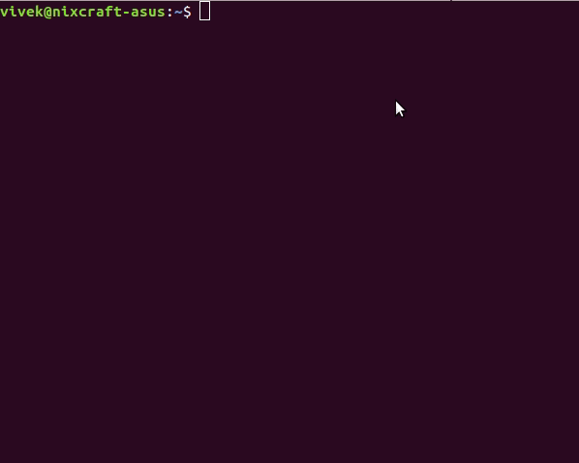
Important user: superuser
superuser or root
is a special user
used for system
administration
purpose on Linux.
sudo (superuser do)
Become a superuser in Linux using sudo command
Source: https://www.cyberciti.biz/faq/linux-login-as-super-user/

Slide 47
System Shutdown
Turn off power – BAD!!!
Reboot
  reboot
  shutdown –r
Halting the system
  halt
  shutdown –h
Changing the Run Level
  telinit <mode>
  shutdown –i<mode>

Slide 48
When to Shutdown
Failures
Maintenance and Upgrades
Regularly Scheduled
  Housecleaning
  Window for Maintenance/Upgrades
User Notification
  /etc/motd
  Email
  Support web pages

Slide 49
References
Daniel P. Bovet and Marco Cesati, Understanding the Linux Kernel, 3rd edition, O’Reilly, 2005.
Robert Love, Linux Kernel Development, 2nd edition, Prentice-Hall, 2005.
Kwan Lowe, Kernel Rebuild Guide, http://www.digitalhermit.com/linux/Kernel-Build-HOWTO.html, 2004.
LWN, “Another Look at the New Development Model,” http://lwn.net/Articles/94605/, 2004.
Joseph Pranovitch, Wonderful World of Linux 2.2, http://kniggit.net/wwol22.html, 1999.
Joseph Pranovitch, Wonderful World of Linux 2.4, http://kniggit.net/wwol24.html, 2001.
Joseph Pranovitch, Wonderful World of Linux 2.6, http://kniggit.net/wwol24.html, 2003.
Claudia Rodriguez et al, The Linux Kernel Primer, Prentice-Hall, 2005.
Andrew S. Tanenbaum, Modern Operating Systems, 2nd edition, Prentice-Hall, 2001.
Linus Torvalds and David Diamond, Just For Fun: The Story of an Accidental Revolutionary, Collins, 2001.

